Slide 1
Environment – energy
Conversational activity

Slide 2



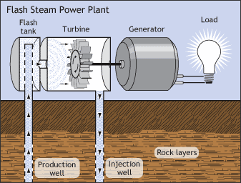


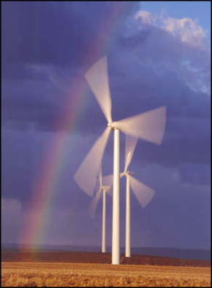
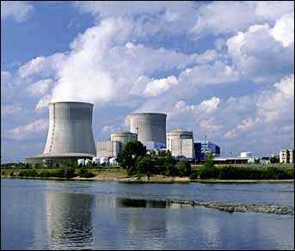

How do we get electricity? Comment on the pictures:

Slide 3
Discuss in pairs
Geothermal
Solar
Hydro
Nuclear
Wind
Bio
Fossil fuels
Describe the sources of energy?
Where in your surrounding can you find these?
Which one is a bit contraversial?
Do you mind wind mills fields in the countryside?
How do we get oil?

Slide 4
Instructions:
1)Use your own words and comment on the first picture
What do you know about sources of energy
What are the alternative sources of energy
What does the word: sustainable mean?
Use vocabulary: sustainable, fossile fuels, exhaustable sources of energy
http://www.pdclipart.org/displayimage.php?album=39&pos=6

